Slide 1

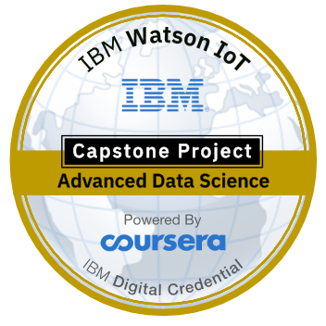
Restaurant recommender system
IBM Capstone project.

Slide 2
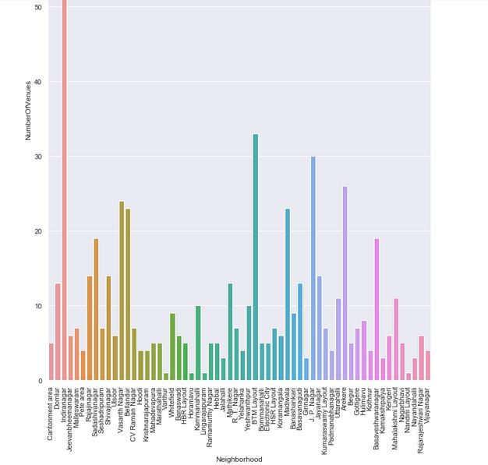
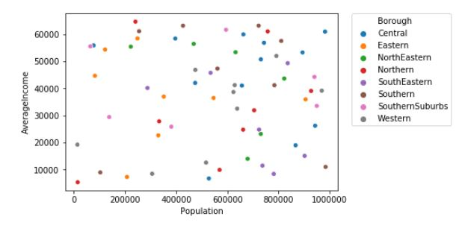
Methodology
Machine learning
Exploratory analysis
Inferential analysis
Recommender System

Slide 3
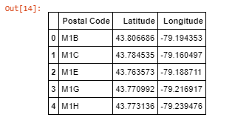
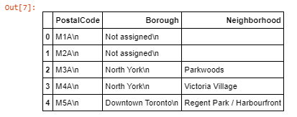
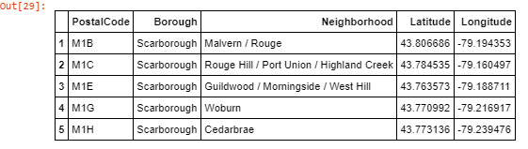
Datasets

Slide 4
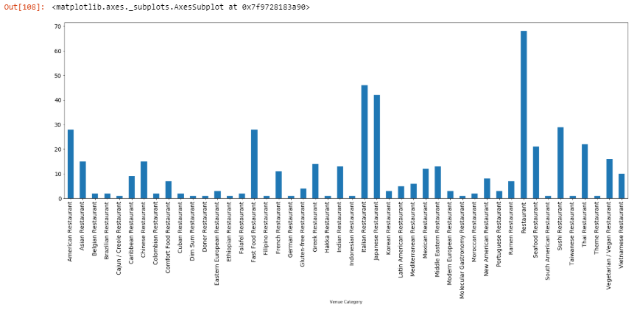

Slide 5

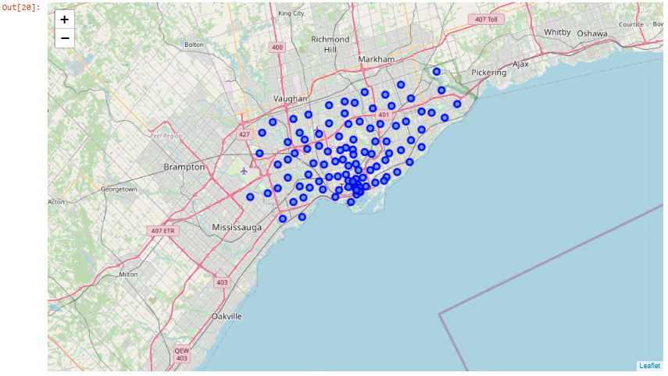
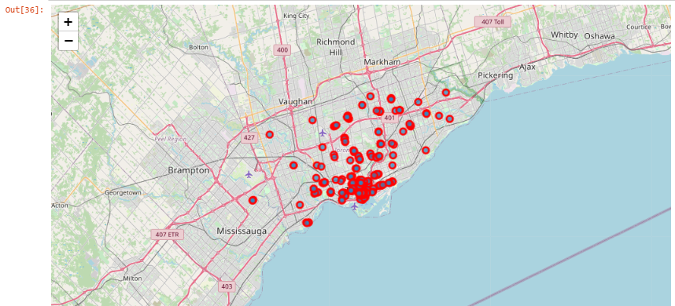
Mapping and clustering

Slide 6
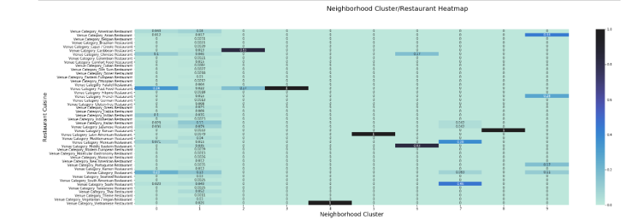

Slide 7
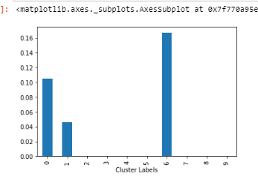
Results and conclusion
Clusters 6,0 & 1 has a high frequent of Chinese restaurants, so try not to open a new Chinese restaurant in clusters 6,0 & 1's neighborhoods.

Slide 8

Thank You!
pklappy21@gmail.com

